Slide 1
Azure Storage
OCC Engineering team
Srichand Jakka

Slide 2
Agenda
1
Azure Storage
2
Blob Storage
3
Storage Redundancy
4
Azure Files
5
Q&A

Slide 3
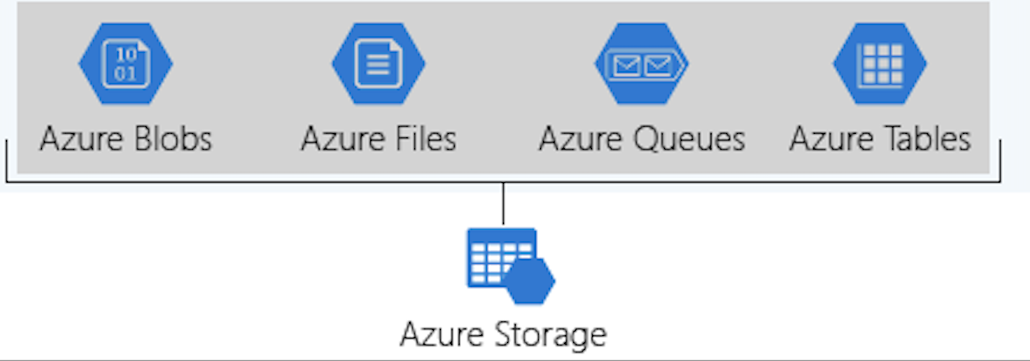
Azure Storage
Provides a unique namespace for the Azure Storage data
Accessible anywhere in the world over HTTP or HTTPS
Secure & highly available
Massively scalable

Slide 4




Azure Storage Services
Blob
Table
Queue
File
Store a large amounts of unstructured data
Store structured NoSQL data, providing a key attribute store with a schema-less design
Store large number of messages and access them from anywhere in the world using HTTP or HTTPS
Message can be up to 64 KB in size
Allow users to access Server-Message-Block-Protocol (SMB) file share in Azure cloud

Slide 5
Azure Storage Endpoints
Storage service | Endpoint
Blob Storage | https://<storage-account-name>.blob.core.windows.net
Data Lake Storage Gen2 | https://<storage-account-name>.dfs.core.windows.net
Azure Files | https://<storage-account-name>.file.core.windows.net
Queue Storage | https://<storage-account-name>.queue.core.windows.net
Table Storage | https://<storage-account-name>.table.core.windows.net
Storage account names must be between 3 and 24 characters in length and may contain numbers and lowercase letters only.
Must be unique within Azure. No two storage accounts can have the same name

Slide 6
Storage Account Types
Type | Supported services | Usage
Standard general-purpose v2 | Blob Storage (including Data Lake Storage), Queue Storage, Table Storage, and Azure Files | Standard storage account type for blobs, file shares, queues, and tables. Recommended for most scenarios using Azure Storage.
Premium block blobs | Blob Storage (including Data Lake Storage) | Premium storage account type for block blobs and append blobs. Recommended for scenarios with high transaction rates or that use smaller objects or require consistently low storage latency
Premium file shares | Azure Files | Premium storage account type for file shares only. Recommended for enterprise or high-performance scale applications
Premium page blobs | Page blobs only | Premium storage account type for page blobs only

Slide 7
Blob Storage
Containers
Organizes a set of blobs, similar to a directory in a file system
Names can be between 3 and 63 characters long
Must start with a letter or number, and can contain only lowercase letters, numbers, and the dash (-) character
Types of Blobs
Block blobs - Store text and binary data. Block blobs are made up of blocks of data that can be managed individually
Append blobs - Made up of blocks like block blobs but are optimized for append operations. Append blobs are ideal for scenarios such as logging data from virtual machines
Page blobs - Store random access files up to 8 TiB in size. Page blobs store virtual hard drive (VHD) files and serve as disks for Azure virtual machines

Slide 8
Blob Access Tiers
Hot Tier
Optimized for frequent reads and writes of objects in the Azure storage account
By default, new storage accounts are created in the Hot tier
Lowest access costs, but higher storage costs than the Cool and Archive tiers
Cold Tier
Optimized for storing large amounts of data that's infrequently accessed
Short-term backup and disaster recovery datasets and older media content
Data remains at least for 30 days
Archive Tier
Optimized for data that can tolerate several hours of retrieval latency
Most cost-effective option for storing data
Data must remain at least for 180 days

Slide 9
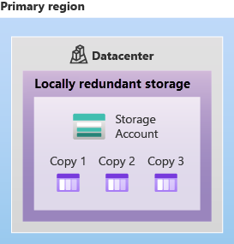
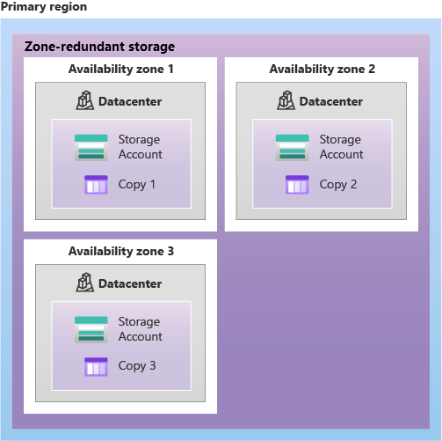
Storage Redundancy
Locally redundant storage
Zone-redundant storage
Replicates the Azure Storage data synchronously across three Azure availability zones in the primary region
Data is still accessible for both read and write operations even if a zone becomes unavailable
Replicates the data three times within a single data center in the primary region
Lowest-cost redundancy option and offers the least durability compared to other options

Slide 10
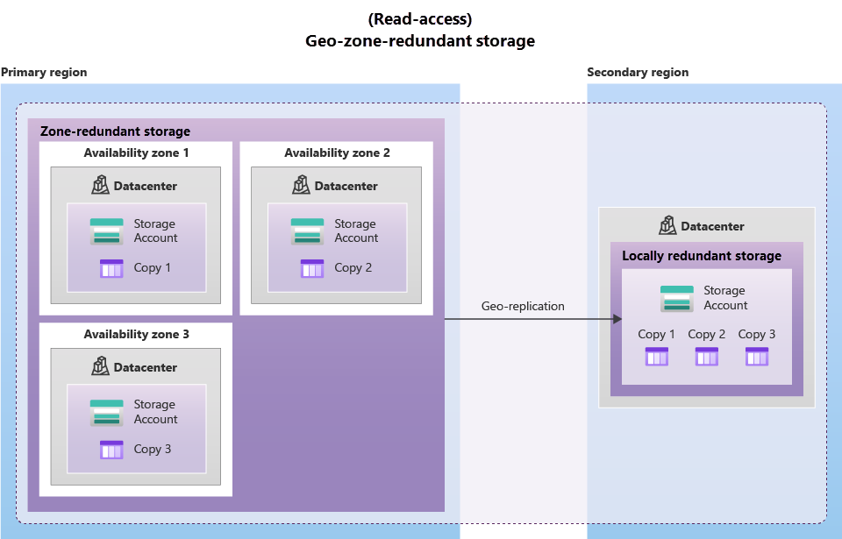
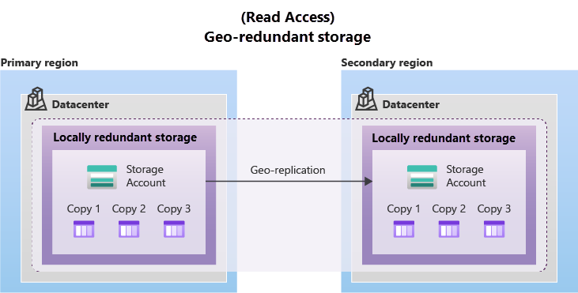
Storage Redundancy
Geo-redundant storage
Geo-zone-redundant storage
Data in a GZRS storage account is copied across three Azure availability zones in the primary region and is also replicated to a secondary geographic region
Microsoft recommends using GZRS for applications requiring maximum consistency, durability, and resilience for disaster recovery.
Data synchronously three times within a single physical location in the primary region using LRS
Copies the data asynchronously to a single physical location in the secondary region (the region pair) using LRS

Slide 11






Storage Security Strategies
Encryption
Authentication
Data in transit
All data written to Azure Storage is automatically encrypted by using Azure Storage encryption
Assign RBAC roles scoped to an Azure storage account to security principals, and use Azure AD to authorize resource management operations like key management
Data can be secured in transit between an application and Azure by using Client-Side Encryption, HTTPS, or SMB 3.0
Disk encryption
Shared access signatures
Authorization
Operating system disks and data disks used by Azure Virtual Machines can be encrypted by using Azure Disk Encryption
Delegated access to the data objects in Azure Storage can be granted by using a shared access signature (SAS)
Authorization ensures that resources in the storage account are accessible only to the users or applications who grant access

Slide 12
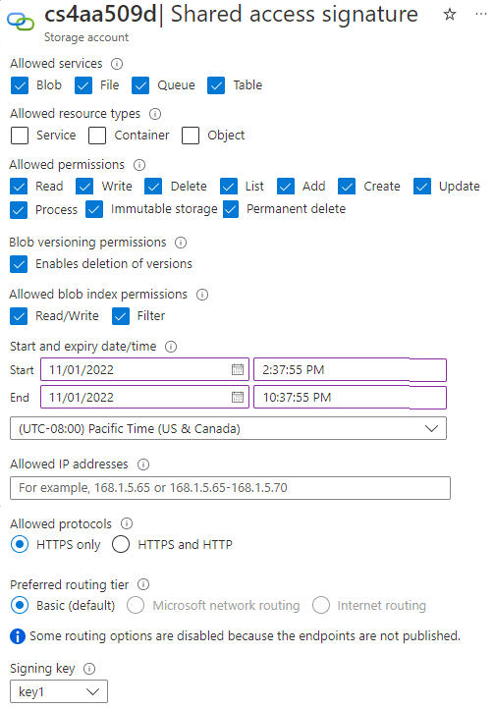
Shared access signature (SAS)
Signing method: Choose the signing method: Account key or User delegation key.
Signing key: Select the signing key from your list of keys.
Permissions: Select the permissions granted by the SAS, such as read or write.
Start and Expiry date/time: Specify the time interval for which the SAS is valid. Set the start time and the expiry time.
Allowed IP addresses: (Optional) Identify an IP address or range of IP addresses from which Azure Storage accepts the SAS.
Allowed protocols: (Optional) Select the protocol over which Azure Storage accepts the SAS

Slide 13
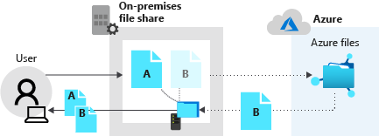
Azure Files
Fully managed file shares in Cloud
Supports Server Message Block (SMB) and Network File System (NFS) protocols
Easy to move all the on-premises files and applications to the cloud for effective file management
Stores data as true directory objects in file shares
Mount and access files shares from Windows, Linux and macOS clients
Azure File Sync
Extend the on-prem file servers into Azure
Cloud tiering
Requires Azure File Sync agent
Storage sync service
Sync group

Slide 14
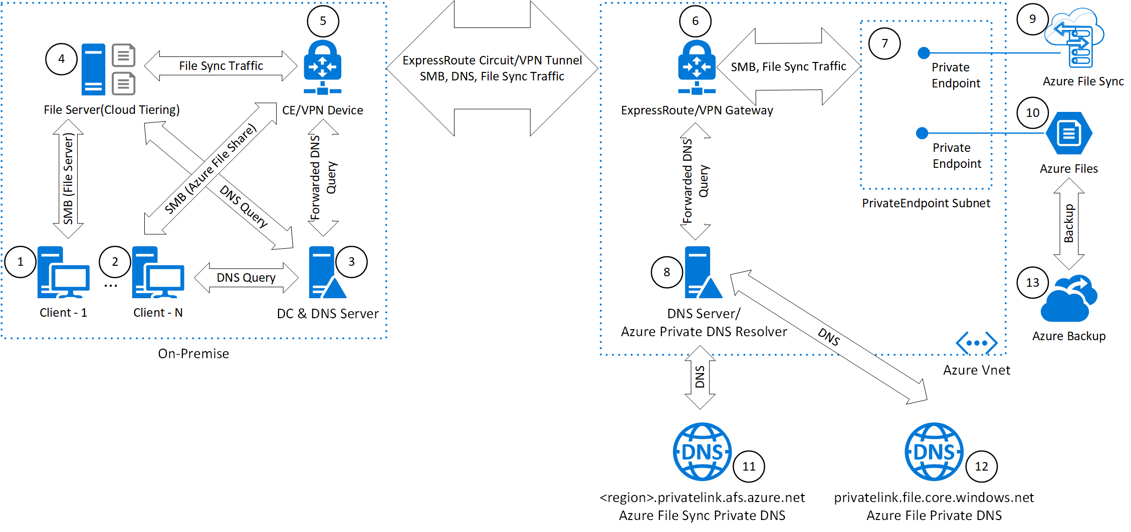
Enterprise Cloud File Share

Slide 15
Azure Storage Explorer
GUI tool for simplified access and management of data stored in Azure storage accounts
Available on Windows, macOS, and Linux
Free to download and use
Manage multiple storage accounts
AzCopy
Command-line utility for copying data to and from Azure Blob Storage and Azure Files
High-performance & reliable data transfers
Copy local files to Azure storage account
azcopy.exe [local_path_to_the_files] /Dest:[blob_url] /Destkey:[access_key_of_the_storage_account]

Slide 16
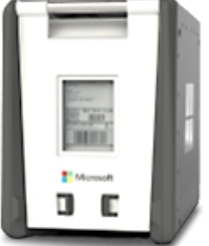
Azure Data Box
Send TB of data into and out of Azure in a quick, inexpensive, and reliable way when network bandwidth is limited
Data Box Storage device is shipped to the customer Datacenter by Microsoft
Once the data is copied, ship the device back to Azure
Maximum usable storage capacity of 80 TB
Use cases:
Onetime migration
Initial bulk transfer
Periodic uploads

Slide 17

Security Best Practices
Enable Azure Defender for all the storage accounts
Turn on soft delete for blob data
Use Azure AD to authorize access to blob data
Use blob versioning or immutable blobs to store business-critical data.
Restrict default internet access for storage accounts
Enable firewall rules
Allow trusted Microsoft services to access the storage account
Enable the Secure transfer required option on all your storage accounts
Limit shared access signature (SAS) tokens to HTTPS connections only
Regenerate the storage account keys periodically

Slide 18
DEMO

Slide 19
Q&A

